Slide 1

Textbook and Syllabus
Probability and Statistics
Textbook:
“Probability and Statistics for Engineers & Scientists”, 9th Edition, Ronald E. Walpole, et. al., Pearson, 2010.
Syllabus:
Chapter 1: Introduction
Chapter 2: Probability
Chapter 3: Random Variables and Probability Distributions
Chapter 4: Mathematical Expectation
Chapter 5: Some Discrete Probability Distributions
Chapter 6: Some Continuous Probability Distributions
Chapter 8: Fundamental Sampling Distributions and Data Descriptions
Chapter 9: One- and Two-Sample Estimation Problems
Chapter 10: One- and Two-Sample Tests of Hypotheses

Slide 2
Grade Policy
Probability and Statistics
Final Grade = 10% Quizzes + 20% Assignments + 20% Midterm Exam + 50% Final Exam + Extra Points
Assignments will be given in fairly regular basis. The average of assignments grades contributes 20% of final grade.
Assignments are to be submitted on A4 papers, otherwise e they will not be graded.

Slide 3
Chapter 1
Introduction
Chapter 1
Introduction

Slide 4
Basic Definitions
Unit
A single entity, usually an object or person, whose characteristics are of interest.
Population of units
The complete collection of units about which information is sought.
A statistical population
It is the set of all measurements corresponding to each unit in the entire population of units about which information is sought.
Sample
A portion of the entire population that are actually collected in the course of an investigation.

Slide 5
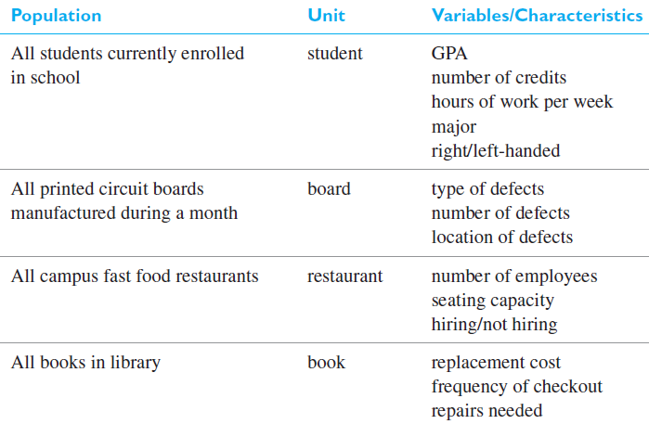
Examples of populations, units, and variables

Slide 6
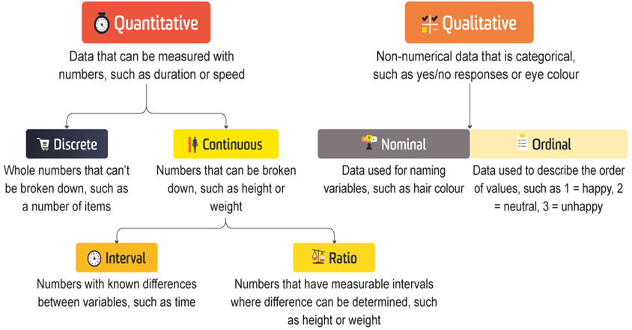
Types of Data

Slide 7
Qualitative vs. Quantitative Data
Qualitative data:
Refers to information about qualities, or information that cannot be measured.
It’s usually descriptive and textual.
Examples include someone’s eye color or the type of car they drive.
Quantitative data:
It is numerical. It’s used to define information that can be counted.
Some examples of quantitative data include distance, speed, height, length and weight.

Slide 8
Types of Measurement Scales
Nominal Scale
Unordered set of categories identified only by name.
Nominal measurements only permit you to determine whether two individuals are the same or different.
For example:
Which brand of smartphones do you prefer?
Apple
Samsung
Others

Slide 9
Types of Measurement Scales
Ordinal Scale
Ordered set of categories.
Ordinal measurements tell you the direction of difference between two individuals.
For example:
How satisfied are you with our services?
Very Unsatisfied
Unsatisfied
Neutral
Satisfied
Very Satisfied

Slide 10
Types of Measurement Scales
Interval Scale
Equal intervals between each value.
Ordered series of equal-sized categories.
Interval measurements identify the direction and magnitude of a difference.
The zero point may be located arbitrary on an interval scale.
For example:
Temperature in Celsius or Fahrenheit
IQ scores
Likert scales (e.g., "Strongly disagree", "Disagree", "Neither agree nor disagree", "Agree", "Strongly agree")

Slide 11
Types of Measurement Scales
Ratio Scale
A ratio scale is a type of measurement scale that has equal intervals between each value and a true zero point.
This means that you can compare the differences between two values on a ratio scale, as well as calculate ratios.
For Example:
How much distance the runner-up lost from the winner in a racing track?

Slide 12
Types of Measurement Scales
Interval vs. Ratio Scale
Interval scales hold no true zero and can represent values below zero.
Ratio scale never fall below zero.
This means that you can say that one value on a ratio scale is twice as large as another value, or that one value is half as large as another value.
Example:
A person who is 1.8 meters tall is twice as tall as a person who is 0.9 meters tall.
A person who weighs 100 kilograms weighs twice as much as a person who weighs 50 kilograms.
A person who is 20 years old is twice as old as a person who is 10 years old.

Slide 13
Statistics
Statistics is the study of the collection, organization, analysis, interpretation and presentation of data.
Statistics is a tool for analyzing data and discovering and proving it’s true meaning.

Slide 14
Descriptive vs Inferential Statistics
Descriptive statistics:
Methods for organizing and summarizing data.
tables or graphs are used to organize data, and descriptive values such as the average score are used to summarize data.
Describe the main features of a dataset, such as its central tendency, variability, and distribution. These methods provide an overview of the data and help identify patterns and relationships.

Slide 15
Descriptive vs Inferential Statistics
Inferential statistics:
Methods for using sample data to make general conclusions about populations.
Inferential statistics is a branch of statistics that uses data from a sample to make inferences about a population.
It allows us to generalize our findings from a small sample to a larger population.

Slide 16
Types of Statistical Studies
Observational studies
Surveys based studies
Experimental studies
Meta-analysis
Retrospective

Slide 17
1-Observational Studies
Observes individuals and measures variables of interest.
It describe a group of individuals or to investigate an association between two variables.
We can answer questions about a population with an observational study.

Slide 18
1-Observational Studies
We can also investigate a relationship between two variables.
But in an observational study, researchers do not attempt to manipulate one variable to cause an effect in another variable. For this reason, an observational study does not provide convincing evidence of a cause-and-effect relationship.

Slide 19
2-Survey based studies
As a field of statistics concentrating on human research surveys.
Survey methodology studies the sampling of individual units from a population and associated techniques of survey data collection.
Survey data collection includes questionnaire construction and methods for improving the number and accuracy of responses to surveys.
Basic type of surveys includes:
Online, paper based, telephonic and one-to-one interviews

Slide 20
3-Experimental Studies
Demonstrates a cause-and-effect relationship between two variables. (All other variables are controlled to prevent them from influencing the results).
It proves that changing the value of one variable causes changes to occur in a second variable.
The manipulated variable is called the independent variable.
Observed variable is the dependent variable.
Notes:
X=5y+90

Slide 21
4-Meta-analysis
A meta-analysis is a statistical analysis that combines the results of multiple scientific studies.
Meta-analyses can be performed when there are multiple scientific studies addressing the same question, with each individual study reporting measurements that are expected to have some degree of error.
This can be done to increase the statistical power of the analysis, to get a more precise estimate of the effect size, and to identify patterns and trends across the studies.

Slide 22
5-Retrospective
This type of study uses strictly historical data, data taken over a specific period of time. One obvious advantage of retrospective data is that there is reduced cost in collecting the data.

Slide 23
Types of Sampling Procedures
Key informant
Snowball
Convenience
Random table/random selection
Stratified
Whole population

Slide 24
Types of Sampling Procedures
Key informant
A specific person that you believe will give you the most information-sometimes used to develop interview questions.
Snowball
You ask the participants to provide you with names of those that will be able to provide you with important information.
Convenience
Simply asking anyone to whom you have easy access. Avoid this if possible.
Random table/random selection
When each person of the population has an equal chance of been selected. Selection is based on random procedure such as using random table of numbers.

Slide 25
Types of Sampling Procedures
5. Stratified sampling
Choosing from various sub-groups. The population is divided into subpopulations and random samples are taken of each subpopulation. For example, stratified by gender.
If the population has 25% females and 75% males, the sample should be chosen randomly by subpopulations and consist of 25% females and 75% males.
6. Whole population
The entire population is used.
This is especially true if the population is small.

Slide 26
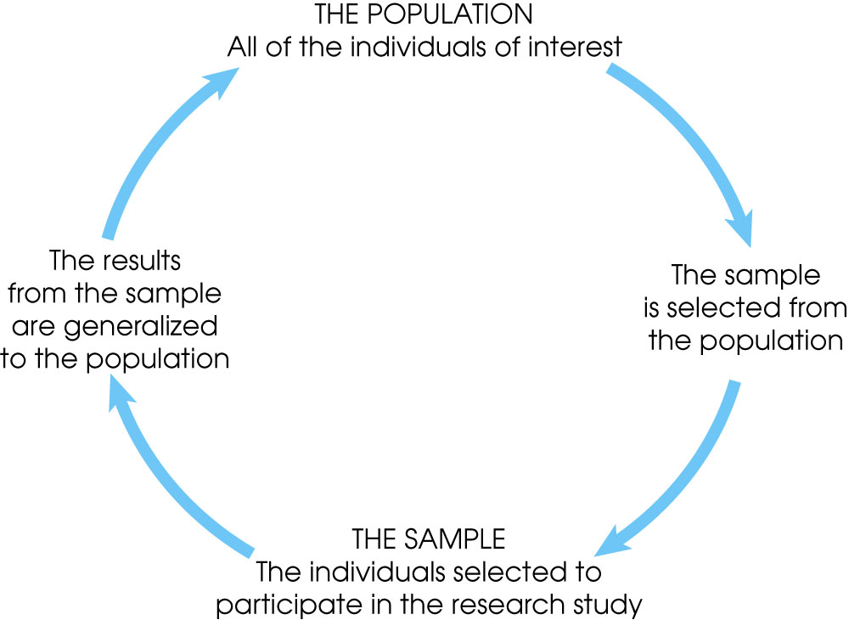
Sample and Generalization

